Slide 1
Road safety
QuadCoders

Slide 2
AGENDA
Briefing on the problem
Solution we came up with
Target audience
Business model
Features we could add
Summary​

Slide 3
Introduction
In today's world road and transport has become an integral part of every human being. The present transport system has minimized the distances but has on the other hand increased the life risk. Every year road crashes result in loss of lakhs of lives and serious injuries to crores of people.
In India, about eighty thousand people are killed in road crashes every year which is thirteen percent of the total fatality all over the world. The person behind the wheel plays an important role in most of the crashes. In most of the cases crashes occurs either due to carelessness or due to lack of road safety awareness of the road user.
Therefore, adequate road safety technology is important to prevent distress and loss of life.

Slide 4
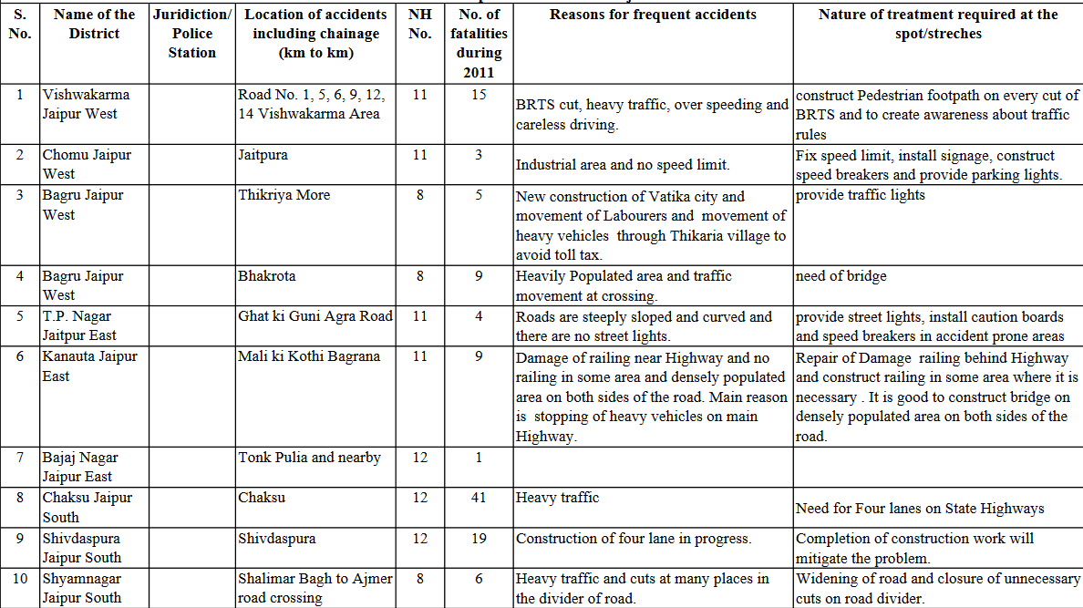
Data on black spots in Rajasthan
(Black spots are areas with a high probability of fatal accidents)

Slide 5
Problems we usually face
Overspeeding, rash driving
Too much traffic
We are quite unaware of the fact of what usually happens under the hood of our vehicle, maybe engines might need regular servicing, or brakes might need cleaning
Poor infrastructure
Lack of data/resources, such as emergency information, hospitals/medical centres near the user

Slide 6
PRIMARY GOAL
Finding a solution to the problem of overspeeding

Slide 7
The solution
So we were thinking about a possible solution for the problem mentioned in the previous slide, and came up with the following alternative :
First have all speed limits set on major and minor roads updated on the app we were to design
When the user goes through a particular area, he/she will get a quick notification/update about the speed limit set in the area
If the user were to exceed the speed limit, after 3 seconds his/her infotainment would beep and alert the user about him/her exceeding the limit
This can help us prevent the common problem of overspeeding and also prevent the user getting fined by the police for the same.

Slide 8
Target audience
Mainly people who drive any 4 wheeler vehicles/heavy vehicles such as trucks and lorries.
This is due to the fact that most accidents involve such heavy vehicles.
The app will help people be more careful and with the added features it can be an useful asset.

Slide 9
Aim of our program
We want to make the roads a safer place for the citizens of our country
We also plan to use some official publicly available data by the Road Transport department of India to make this app a success
Some useful features are also to be added once our main purpose of the application is achieved
With support and perfect advertising we can make our app a great tool for all drivers across India

Slide 10
Business Model
To generate revenue, we can add few non-intrusive advertisements.
We can also add a premium service for the additional features we are going to provide after the implementation our aim.

Slide 11
Features we could add as future prospects
An auto-tracker which checks the condition of the vehicle with a series of simple tests
Alert the user in advance about the road condition ahead and suggest an alternative route for easier travel
Reminder for the user to take his/her driver’s license, car insurance, RC etc. to avoid police fines
Nearby mechanics
An option to buy insurance from different banks to stay secure

Slide 12
SUMMARY
To summarize, we hope that the app we develop can benefit people in a positive way and instill a sense of safety and cooperation in the fellow citizens of our country.

Slide 13
THANK YOU
QuadCoders,
Prathamesh Nimkar
Aniket Shivam
Tarun Pradhan
Omkar Shete

